Slide 1
Function Daughter B’d
Asic Daughter B’d
MIC block
BLE block
Header block
Header block
GND_Rx
E-7150 block
Out
CH
ASIC
GND_Tx
FPGA block
Tx
PMIC block
Rx
PMIC block
USB Power
Zinc-Air Power
Tx
Link block
Rx
Link block
Header block
Header block
Tx
Coil
Rx Coil

Slide 2
CONA1
U9
C39
C25
C44
C51
C65
C26
C27
AI3
AI2
AI1
AI0
C40
Analog_out
Analog_In
C19
U8
BLE
CON88
C5
U7
C45
C46
C47
C41
C24
C48
C49
C50
U13
C42
C18
C6
Tx_1.2V
Tx_1.8V
U10
CON89
C3
C7
LED_block
C37
Tx_3.3V
Tx_2.5V
CON1
U2
C38
C10
C11
C8
C9
C4
C126
C2
SW1
U11, U12
U15
U14
LED1
SW_block
Zinc-Air Power
C14
C28
C32
C36
Back_Tel
U16
U17
BT1
C17
C31
R46
C12
C76
C77
BT2
C35
C61 – C64
C75
C13
BT3
BT4
SW2
C43
C74

Slide 3
C92
C90
C91
RBAR
C112 – C115
NRT
CON88
C95
C99
Channel_On
C119
C96
C98
C121
CH1
CH32
CON89
C123
BGR
C120
C97
C94
C118
U24
C124
C93
C117
CH16
CH17
Rx_1.8V
Rx_5V
C122
Rx_9V
Rx_3.3V
BIAS_V
D3 - D6
Rx_18V
C79
C80
C81
Rx_1.2V
C78

Slide 4
Rx copper
Copper X
1/2층
1층
CON84
C51
C52
D9
Q8
D3
D4
D6
D5
Q9
1층
1층
D7
C48
D8
C49
C50
C47
C46
CON81
C45
CON80
C44
CON79
CON78

Slide 5
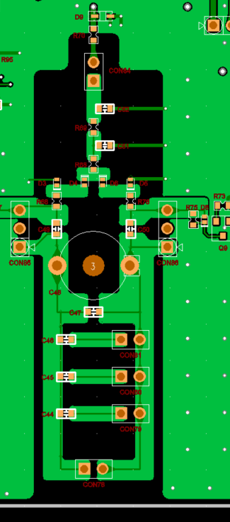
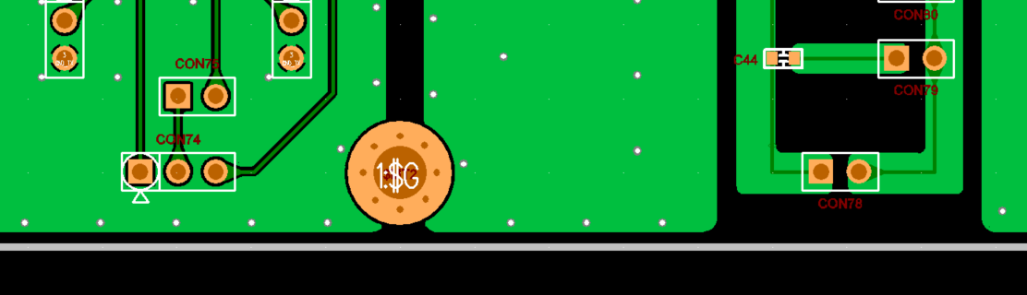
이 영역까지 1층copper
GND
3,4층 copper 제거
CON75 위로 3mm이동
CON74, 78 아래로 가능한 영역까지 이동

Slide 6
C95
C99
C96
C98
C97
C94
C93
RP4

Slide 7
Coil_DUT 1
2층
1층
4층
Coil_DUT 2
2층
4층

Slide 8
CON4
CON29
CON5
U6
U7
CON9
U8
CON3
CON24
CON27
CON14
CON15
CON21
CON30

